Slide 1
Name of subject matter here
Name:
Date:
Research Conducted : DATE 1 through DATE 2
Abstract : example – Observing the changes to different colored hamburger wrappers over a 4 week period.

Slide 2
The basic approach
Define the question
Gather information and resources (observe) - Define a single variable to study
Form hypothesis
Perform experiment and collect data
Analyze data
Interpret data and draw conclusions that serve as a starting point for new hypothesis
Publish results
Retest (frequently done by other researchers)

Slide 3
Subject Matter and Hypothesis -
State what you are interested in understanding better:
EXAMPLE - Hamburger Wrappers from 3 popular chain restaurants
State your opinion of what will be observed
EXAMPLE: Based on other similar research, I believe we will see significant differences in the rate of noticeable aging between colors on hamburger wrappers. I believe hot pink wrappers will age the most and black wrappers will age the least.

Slide 4
Methodology
State what you did to make the necessary observations over time.
EXAMPLE: I obtained 3 sets of wrappers from 3 different hamburger vendors.
I cleared a section of my back yard approximately 2 foot by 8 foot and placed markers around this area to protect it. I made sure all areas of the box had equal lighting and exposure to natural elements.
I placed 1 set of 3 wrappers side by side on the ground each week for 3 weeks.
I made observations 3 X per week at approximately the same time per day, and took notes and made drawings to track changes, finally noting specific differences between 3 week old, 2 week old, 1 week old and new wrappers.
(recommended-draw, take notes, and take pictures)

Slide 5
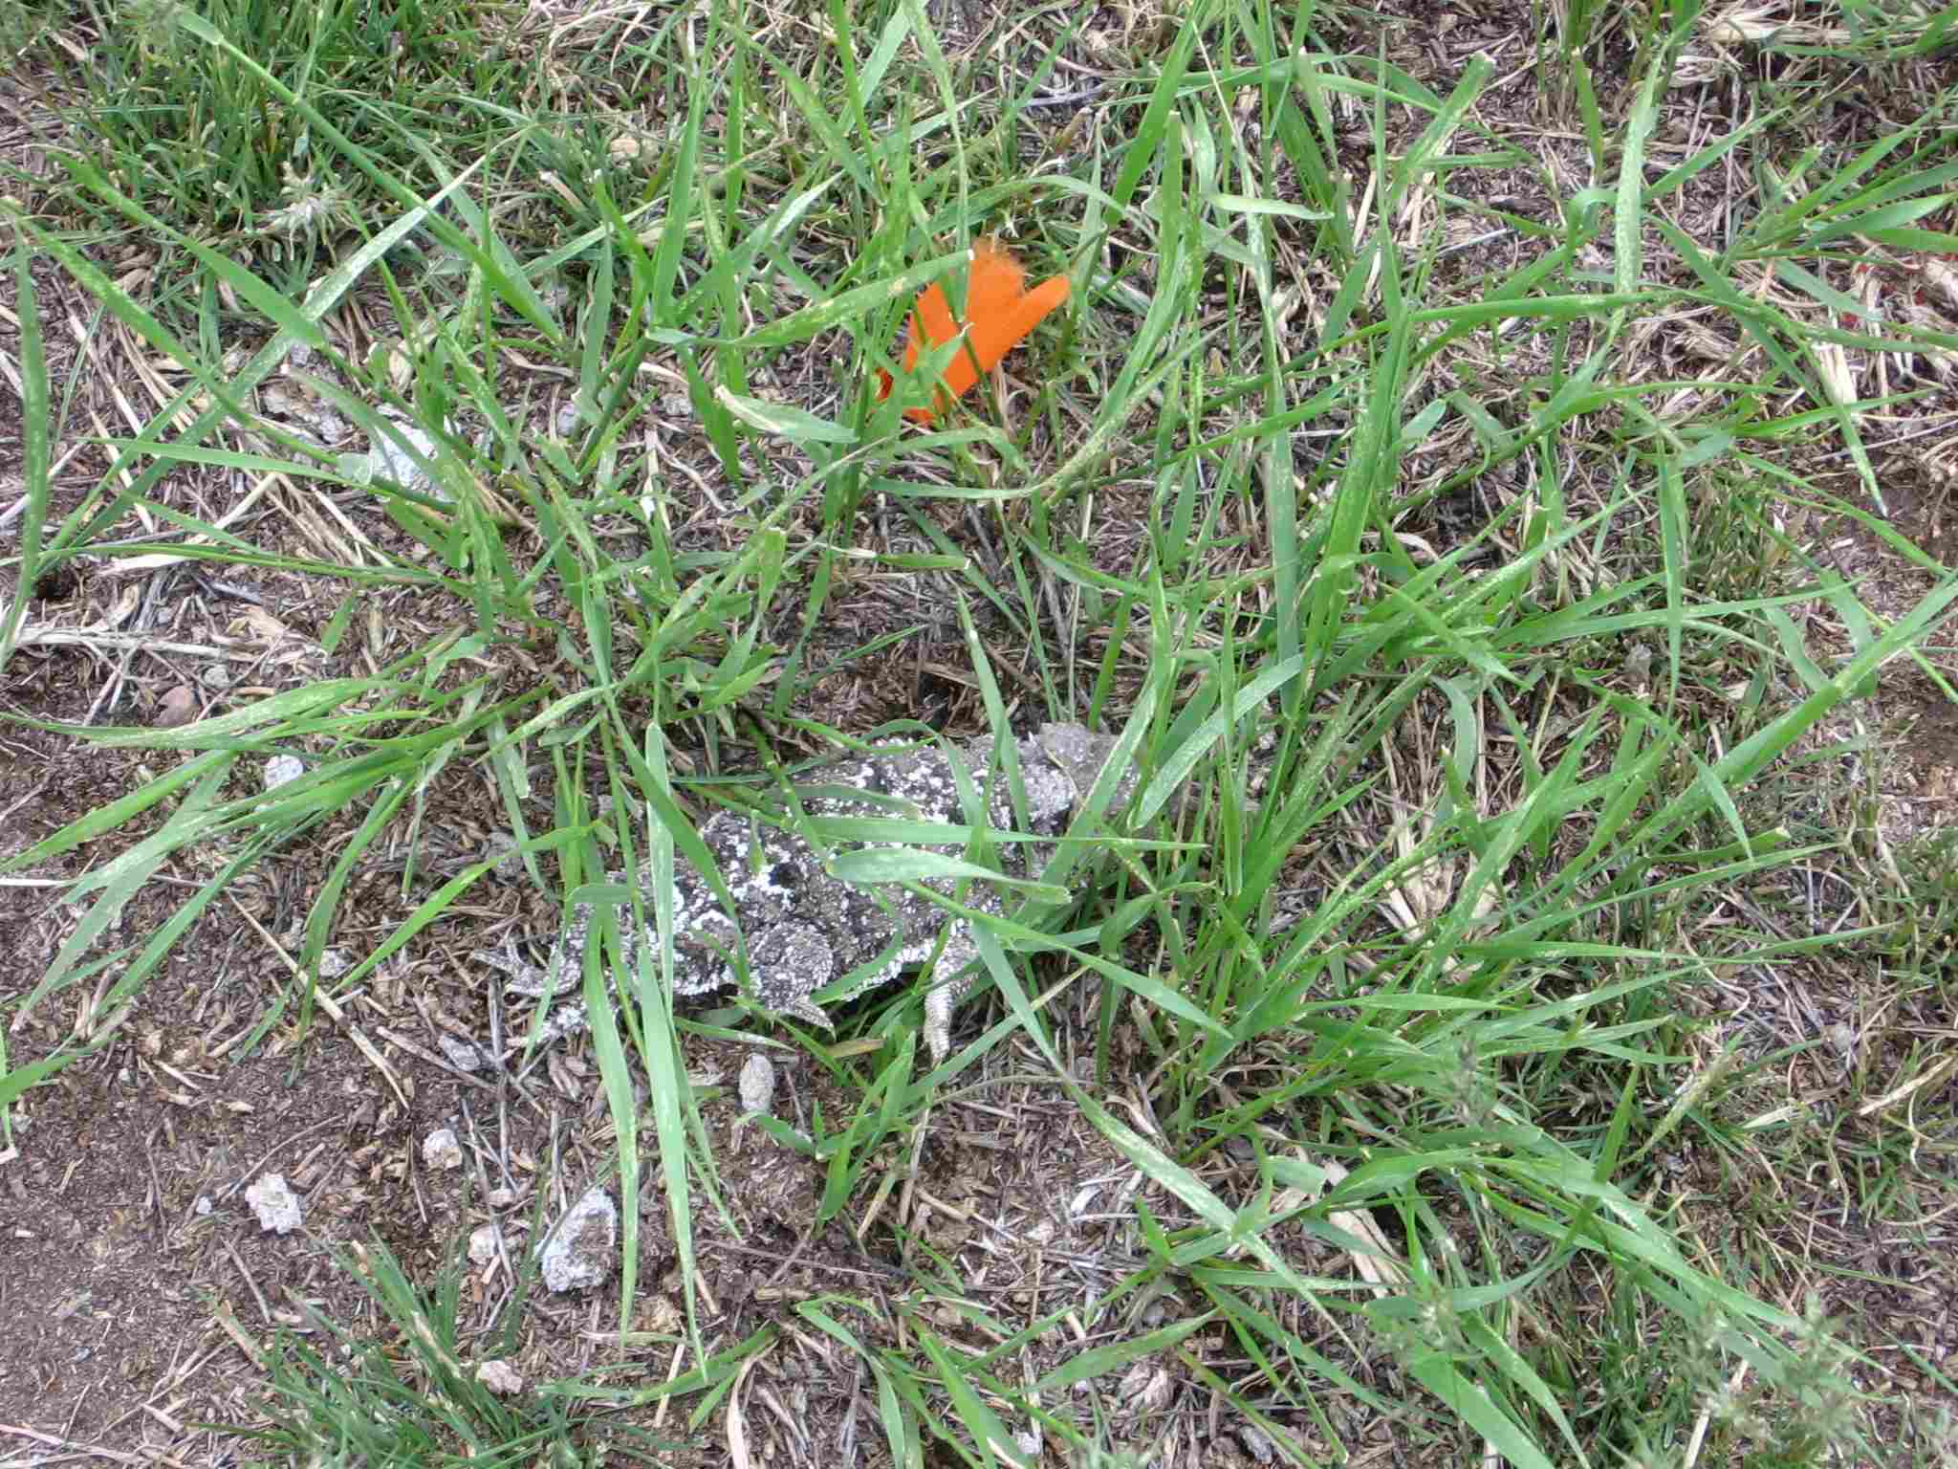
Observation 1
Description
Use the most representative photo of a single wrapper, the most aged, or the least aged, to match your description in each observation.
NEW Week 1

Slide 6
Observation 2
Description
Week 1 Week 2

Slide 7
Observation 3
Description
Week 2 Week 3

Slide 8
Final Observation
Description
New Photo Most changed

Slide 9
Conclusions, possible use, and future suggestions
State how your observations proved or disproved your hypothesis (your original opinion).
EXAMPLE - As shown in the 4 observations described here, my original opinion was proved that hot pink wrappers aged must faster than an all black hamburger wrappers.
Trackers may be able to more readily recognize the age of hamburger wrappers when these clues are found if they remember that hot pink ages faster than black.
I believe it would be beneficial for wrapper materials to be tested in a similar manner, possibly controlling for colors and material types as much as possible.

